Slide 1
Sierra Users Group
Kickoff Meeting
Supported by MHLS TechOps Team:
Laurie Shedrick, Thomas O’Connell, Gerry Formby, Nina Acosta,
Tara Stohr, Kerri Carpenter, Isaac Barbee, Matthew Reinhardt

Slide 2
Agenda
Introductions
The ILS “Road Map”
Inspire
Knowledge Base
Open forum – What’s on your mind?

Slide 3
Sierra Users Group
Who are we?

Slide 4
We are a group of people who…
Use Sierra! … Within the Mid-Hudson Library System
Who want to share ideas
Who are curious or want to learn new skills and tricks
Who want to improve the services to our patrons
Who want to improve the processes that we have in place
Who want to move the Sierra and Encore platform forward
Library Staff * Directors * IT * MHLS Staff

Slide 5
Sierra Users Group
What are we?

Slide 6
We are a group of people that…well, let’s see…. At the end of the day, we will ask ourselves these questions.
How should this body/meeting/environment be managed?
What is our mission or purpose?
Do we have immediate goals?
How will we create an agenda?
How often should we meet?
Is this something we want to do?
What value does it have?

Slide 7
Who are you?
Which Library?
What do you do?
Do you have … (something xtra)
Something you hope to learn?
A favorite part of your job?
Something that really needs a fix?
A Super Power?

Slide 8
ILS Road Map
A collaborative path forward

Slide 9
A plan or strategy intended to achieve a particular goal
Notes:
Having an ILS Roadmap means we have an agreed upon plan with milestones and delivery expectations for all stakeholders.

Slide 10
SMS text messages
Go Live: The DA will determine that on 9/6
Milestones
Implementation : Completed and in testing on our staging site
Patron education: Available on New KB
Description: Sends text messages to patrons for the following when notices are triggered.
Staff have a mobile interface to manage collections into the stacks
No new workflows for task management
Library Readiness
Review talking points
Review FAQ

Slide 11
Messages include:
As notices are queued for delivery as the entry is placed in the standard queue.
Courtesy Notices
Hold Pickup Notices
Hourly Overdue
Overdue

Slide 12
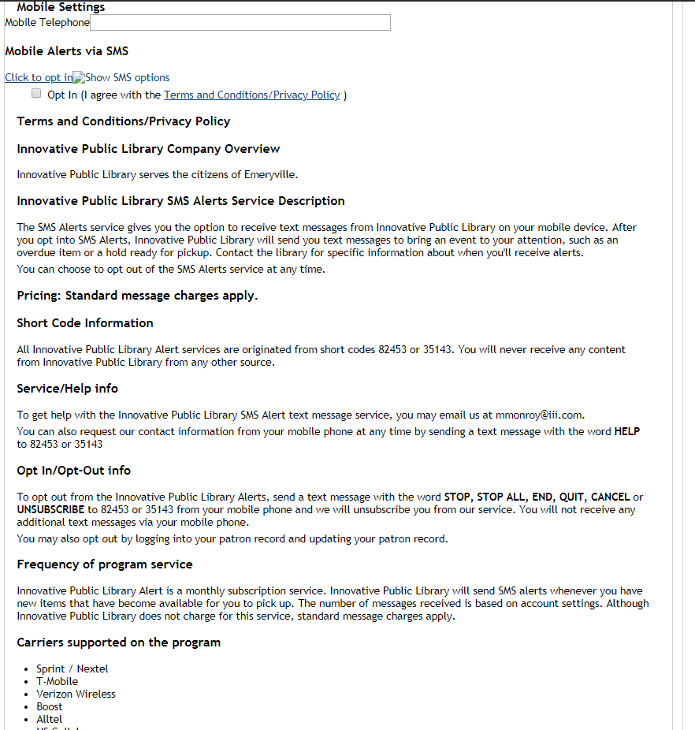
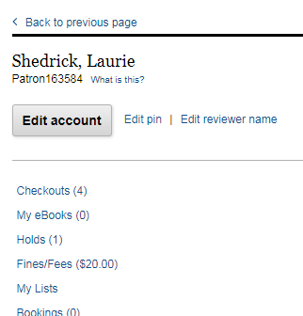
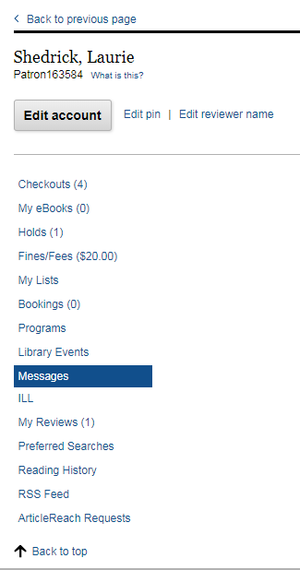

Slide 13
Discussion: SMS Text messages
Pros
Cons
Text will be convenient and popular
No extra tasks for staff
Easy to deploy
Patrons opt in/out
Only for notices
Duplicates – does not replace notice
Limited to notice types

Slide 14
Decision Center
Go Live: Q3-4 2019
Milestones
Data Conversion and Implementation: Installation in progress! 8/7-8/24
Training Dates: TBD – announced soon.
Training Videos
Documentation
Description: Decision Center is a comprehensive collection management and analytics solution that provides timely and focused action recommendations for budgeting, selection, weeding, floating, and more. Decision Center helps libraries match supply and demand to deliver optimized service. By using current and complete data—about circulation, holds, transits, patrons, and acquisitions—Decision Center provides you with actionable insights to help your library improve patron-driven acquisitions while streamlining collection management workflows.
Reports easier to manage
More Features and Access to Data
Trend analysis
Improved analytics for Encore
Training
Setup Categories and Collection definitions

Slide 16
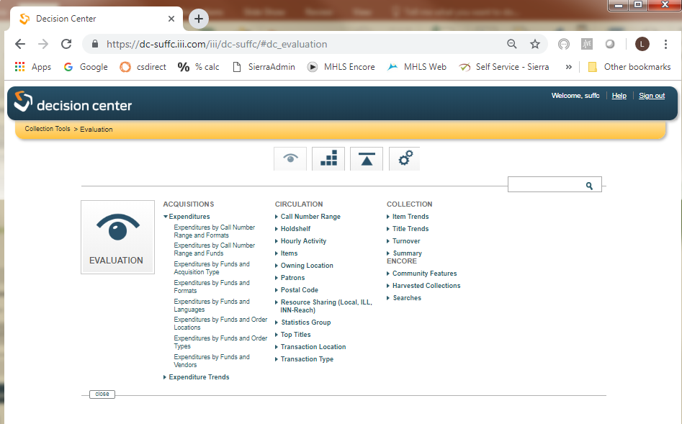

Slide 17
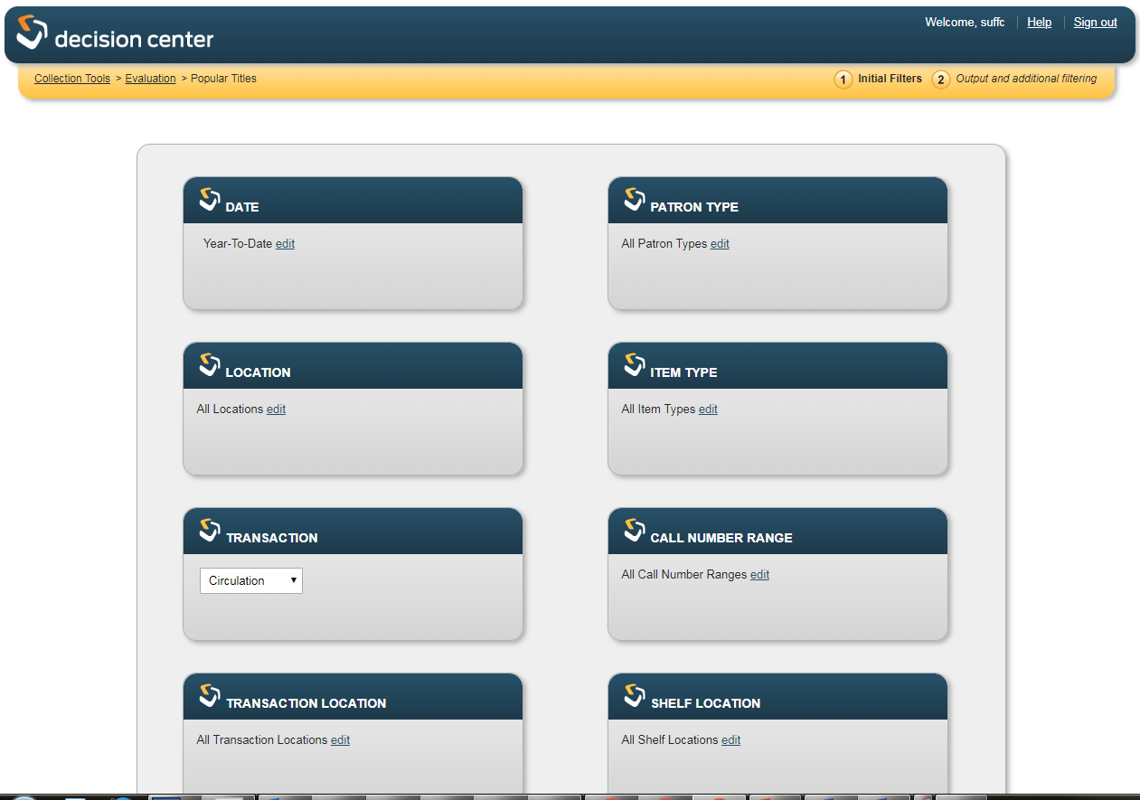

Slide 18
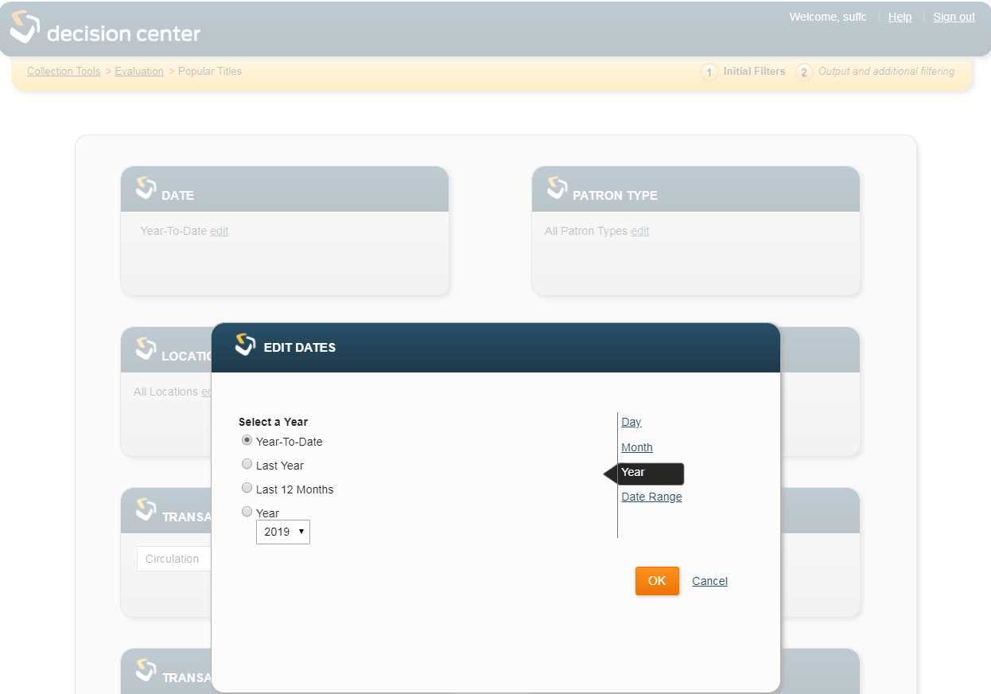
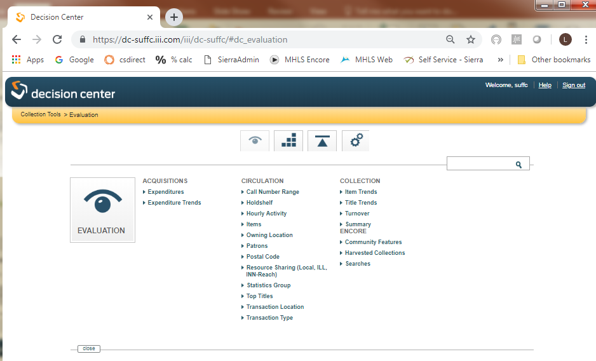

Slide 19
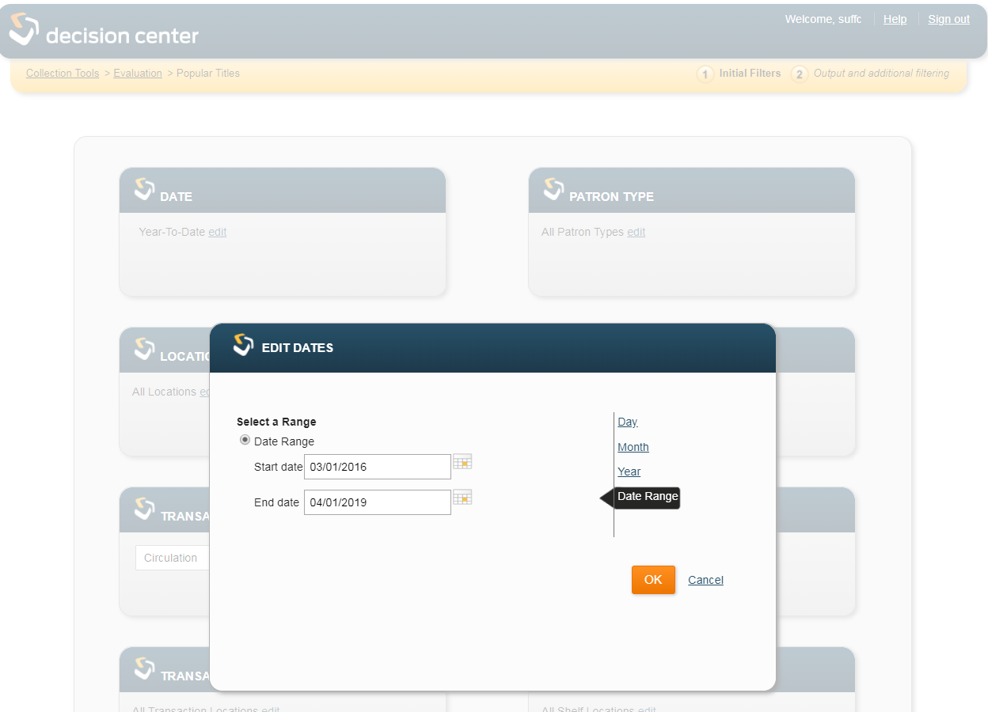

Slide 20
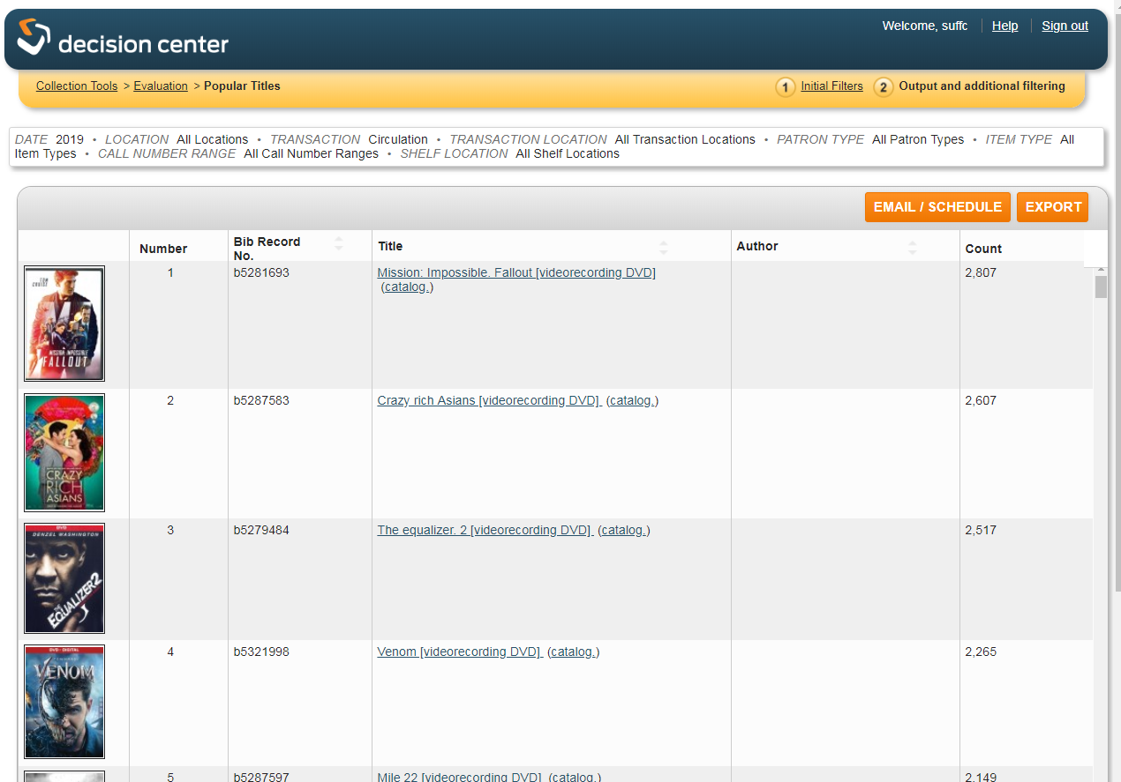
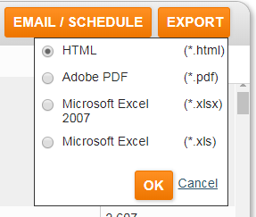

Slide 21
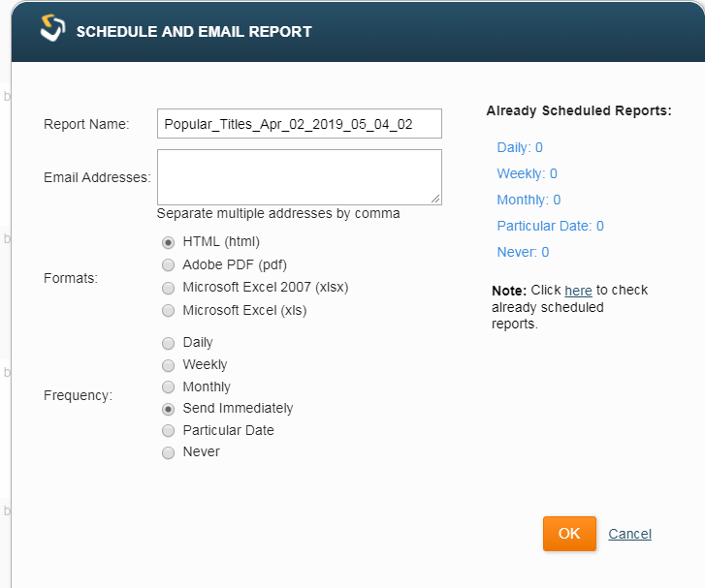

Slide 22
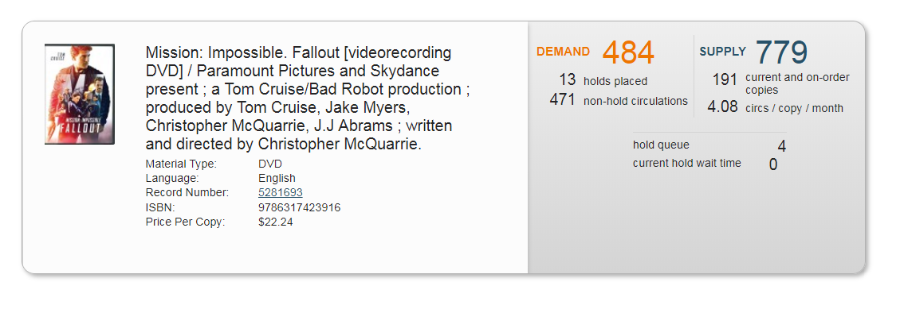

Slide 23
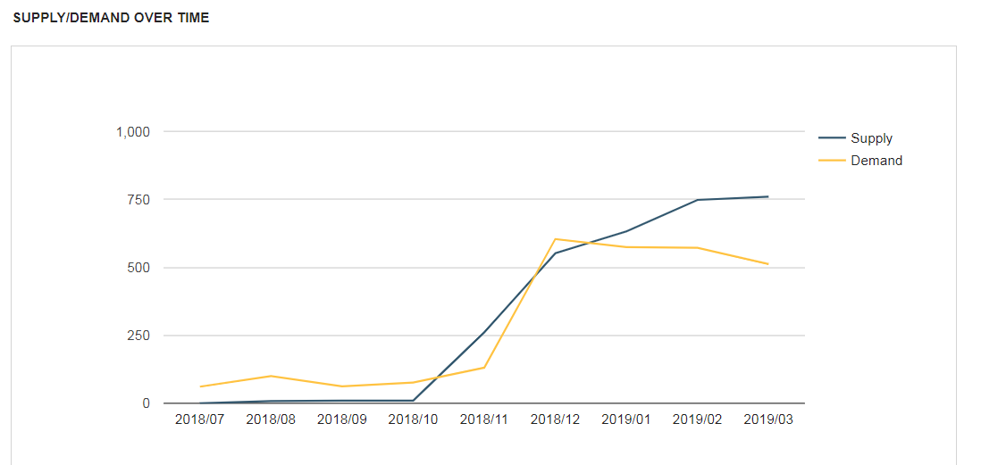

Slide 24
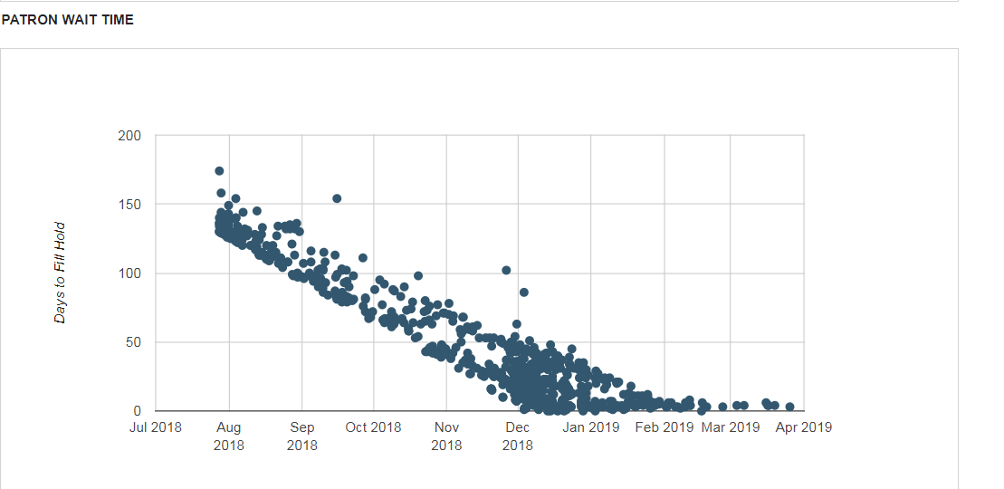

Slide 25
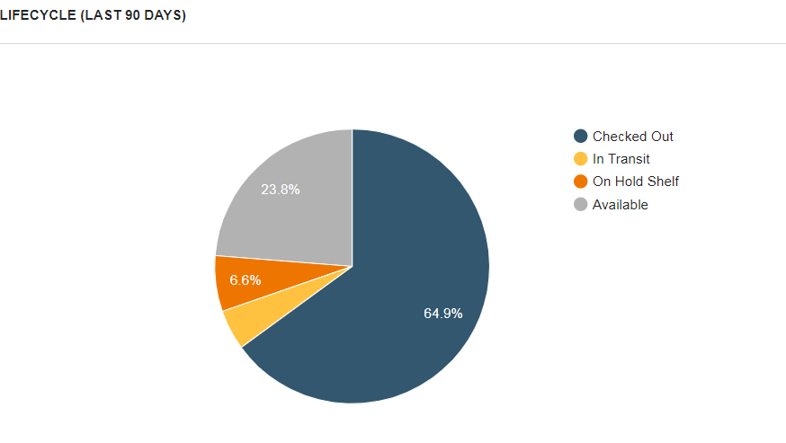

Slide 26
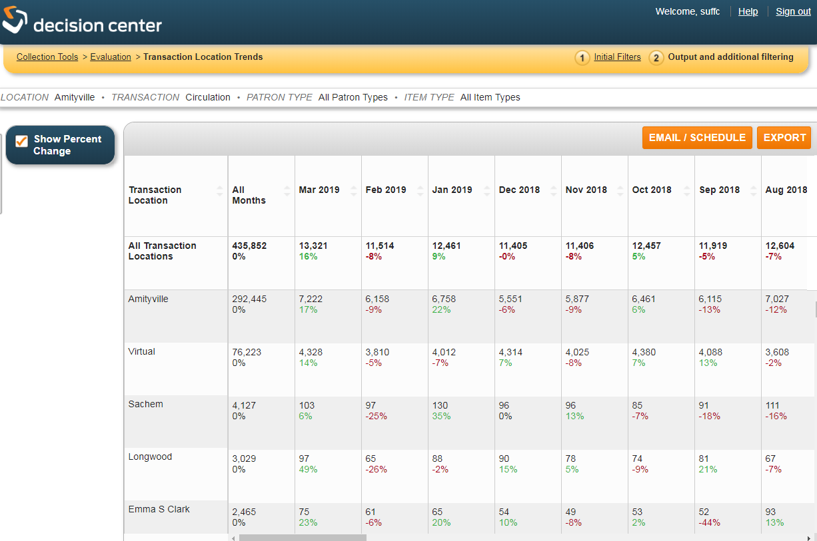

Slide 27
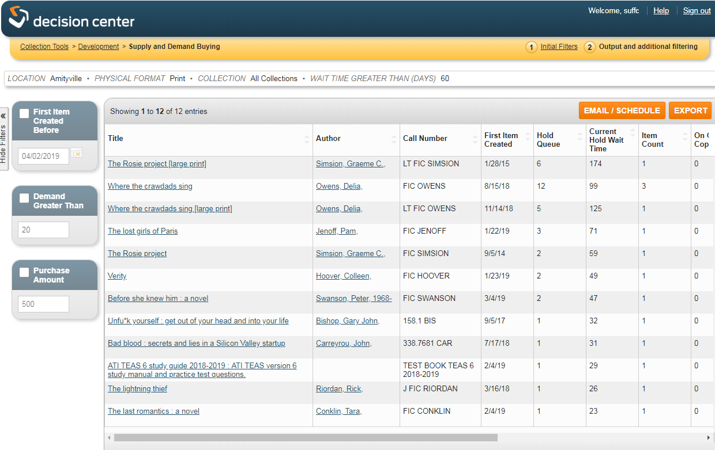

Slide 28
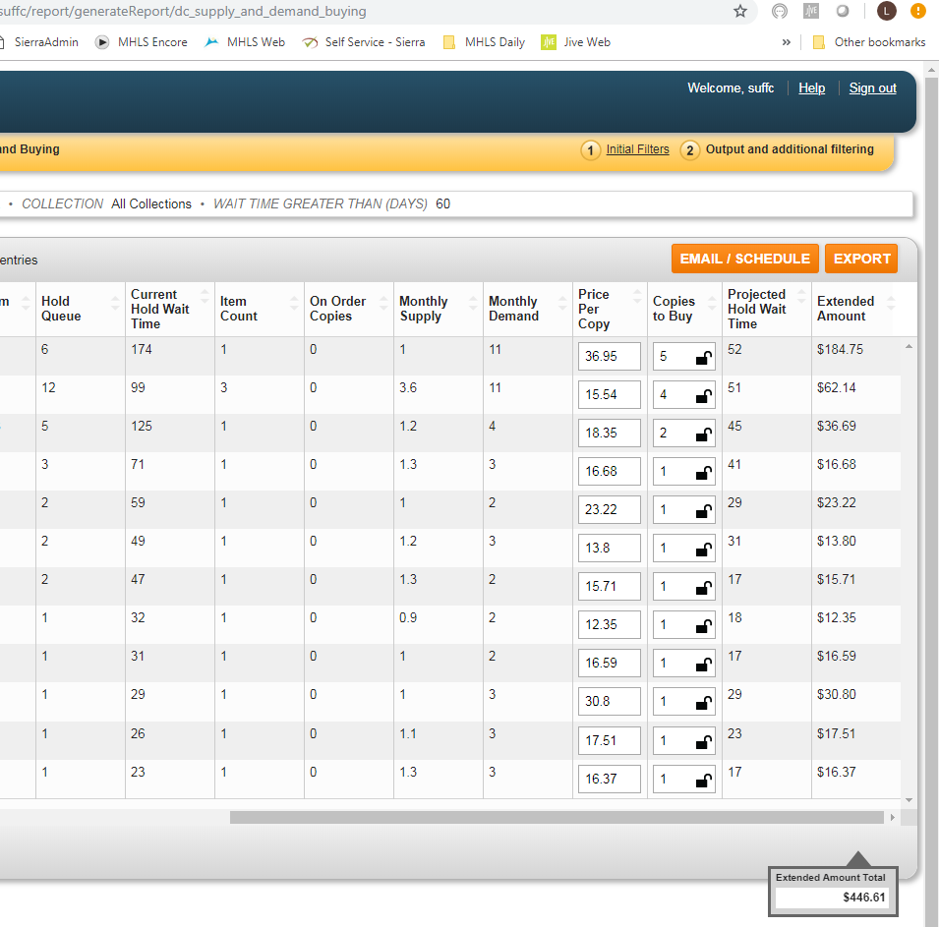

Slide 29
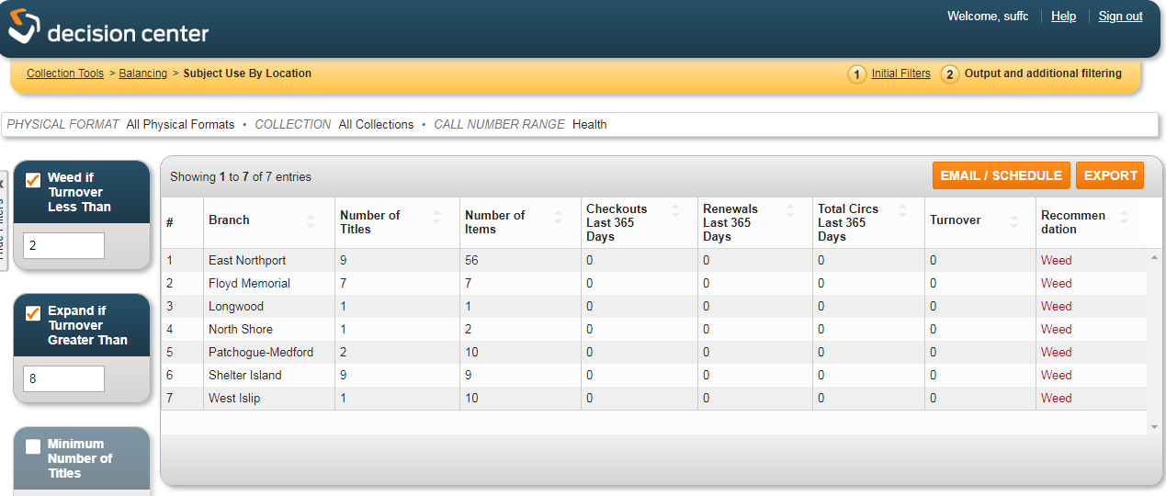

Slide 30
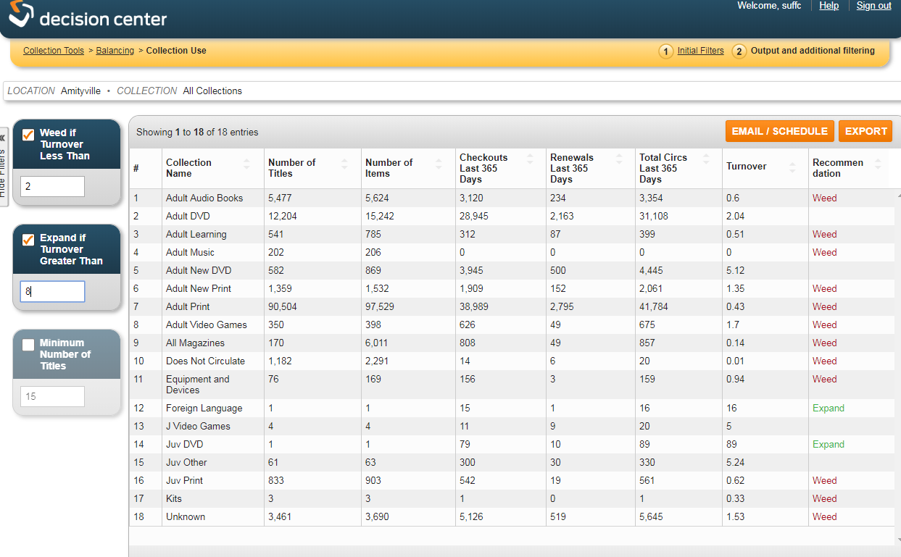

Slide 31
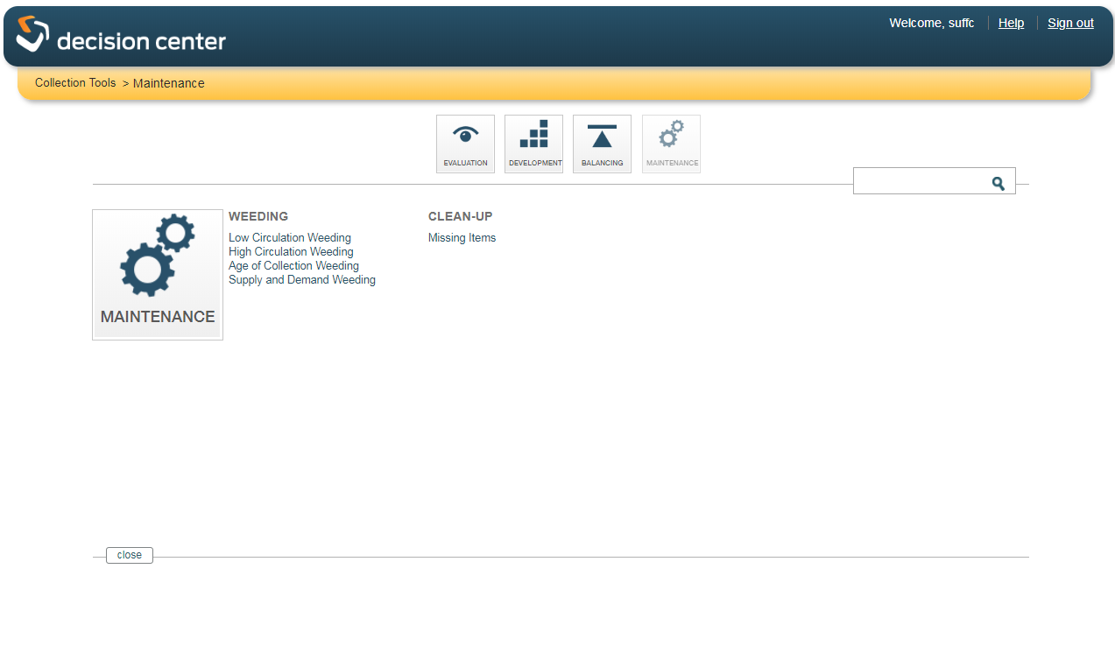

Slide 32
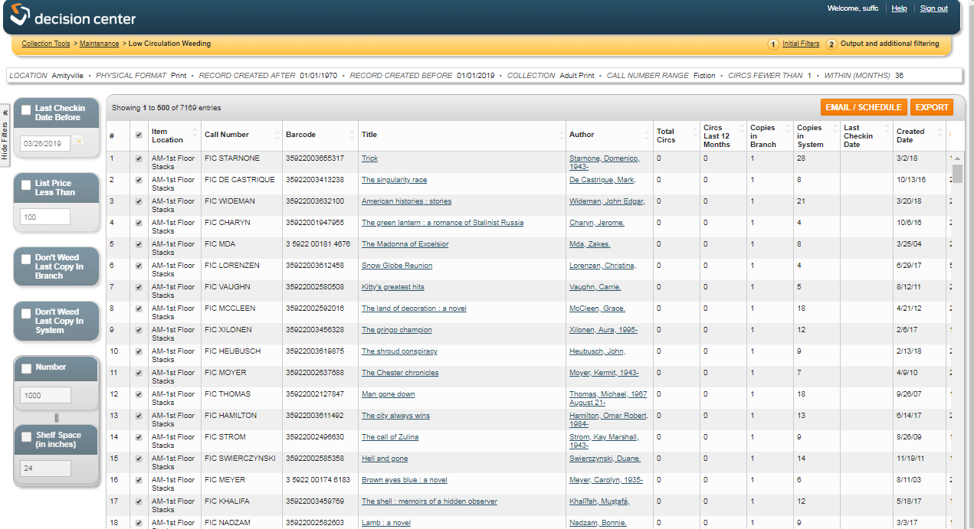

Slide 33
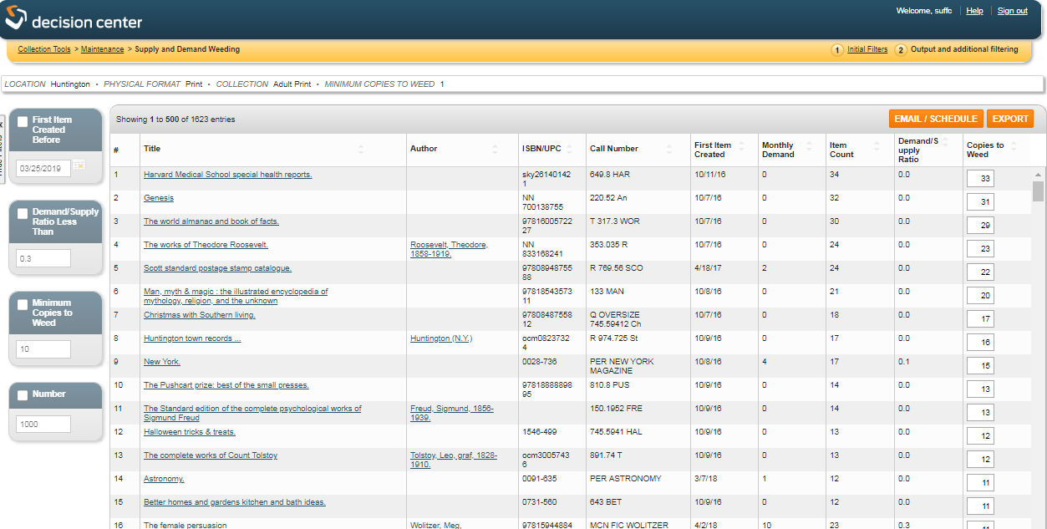

Slide 34
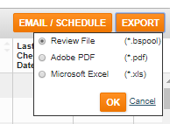

Slide 35
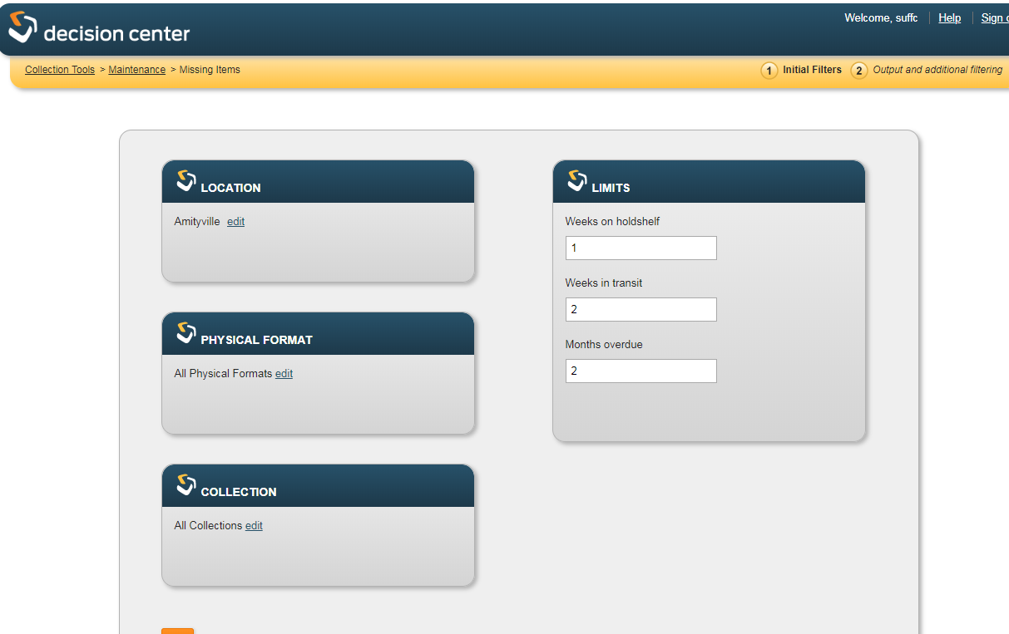

Slide 36
Discussion: Decision Center
Pros
Cons
Streamlines reports
Title level data available
Schedule reports
Workflow improvements – store to review file
No maintenance of files
Reports can be made more granular through second level filters.
Exports easily
Better date control
Reports are very, very slow in prep
Call number table (SCAT) plays a big role and needs an overhaul
Limited to what reports are available
Development and enhancements have been slow
Requires a high level of understanding of record fields – not street ready.
Files not saved externally
Non Dewey Libraries call # reports

Slide 37
Mobile Worklist
Go Live:
Milestones
Implementation : not yet planned
Staff Training: To be announced / Regional and recorded
Description: Reduce the back and forth between the stacks and the desk, cut down on repetitive materials handling, and decrease reliance on paper reports with Sierra Mobile Worklists.
Mobile Worklists is a native iOS app that makes materials handling and management tasks more efficient, saving time and paper for library staff. Fully cloud-based, Mobile Worklists provides new functionality for Impact
Staff have a mobile interface to manage collections into the stacks
New workflows for task management
Library Readiness
Equipment recommendation
Training

Slide 38
Workflows
Weeding
Searching projects
Placing items on display
Relocation projects – moving items to and from storage, between branches, and throughout the library
Managing new collections
Generating lists of course reserve items
Labeling projects
ILL delivery tracking
Inventory projects
The ability to e-mail lists from the mobile device to other library staff, faculty, students, or patrons interested in a specific set of materials
The option to e-mail lists as CSV files, to be opened in spreadsheet applications

Slide 39
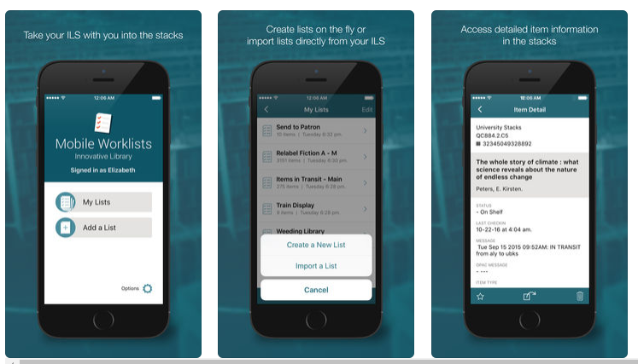

Slide 40
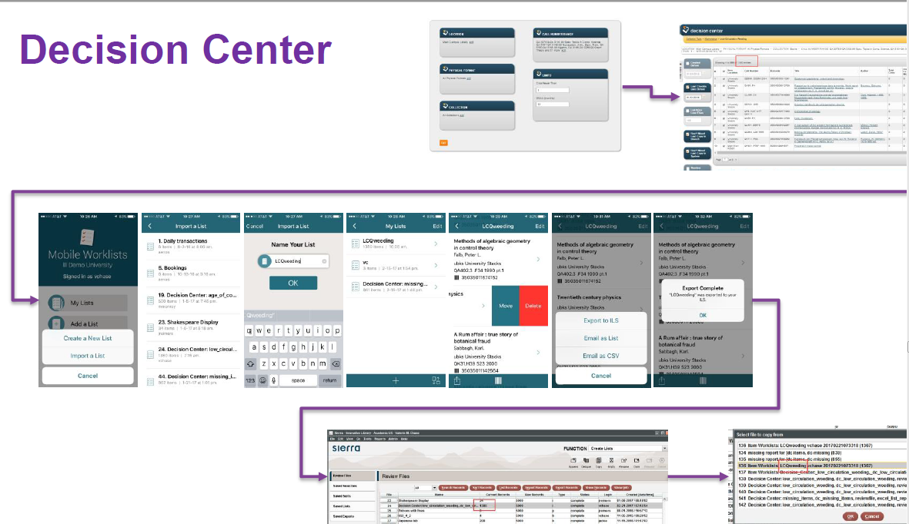
To Mobile Worklist
To Sierra

Slide 41
Discussion: Mobile worklist
Pros
Cons
Manages stacks work in the stacks
Integrates with Sierra
Manages projects/relocation
Only iOS
Requires device/liability
Limited in tasks
Requires a high level of understanding of record fields – not street ready.
Files not saved externally
Will take some use case work to develop real value

Slide 42
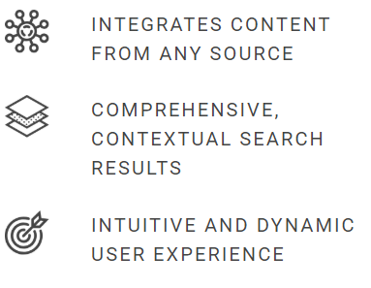
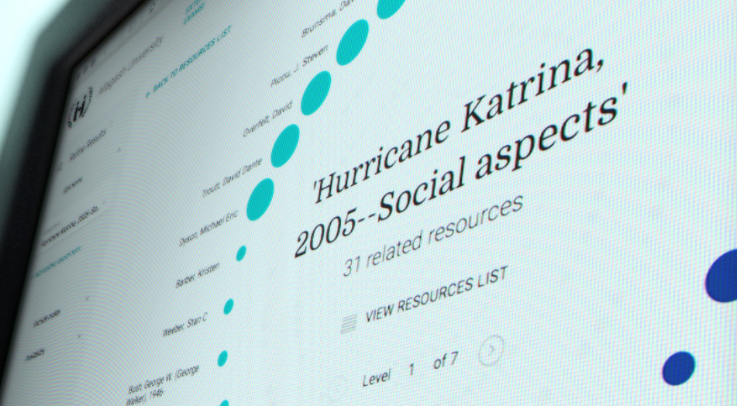

Slide 44
New Knowledge Base
kb.midhudson.org
https://mhlsknowledge.wpengine.com/

Slide 45
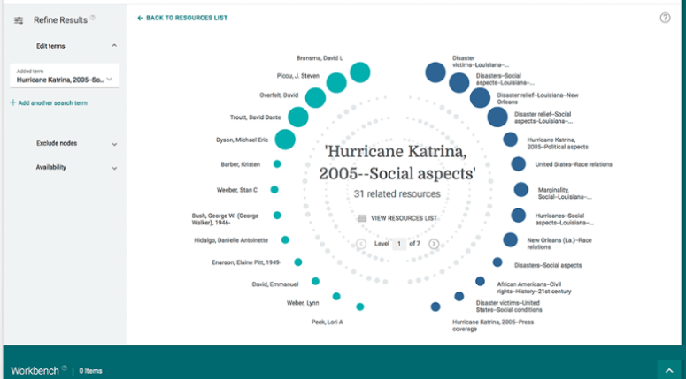

Slide 46
Thank you!

Slide 47
How should this body/meeting/environment be managed?
What is our mission or purpose?
Do we have immediate goals?
How will we create an agenda?
How often should we meet?

